Slide 1

information Security at Harper College
By Ian Myers

Slide 2

My Objectives
Update the Information Security HIP and external Page
Prepare Mock Phishing Emails
Explore Options for Student Phishing Training
Create security awareness training for 2023

Slide 3
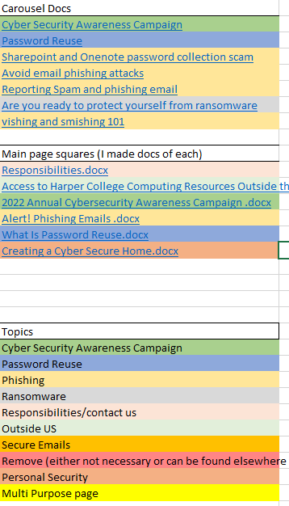
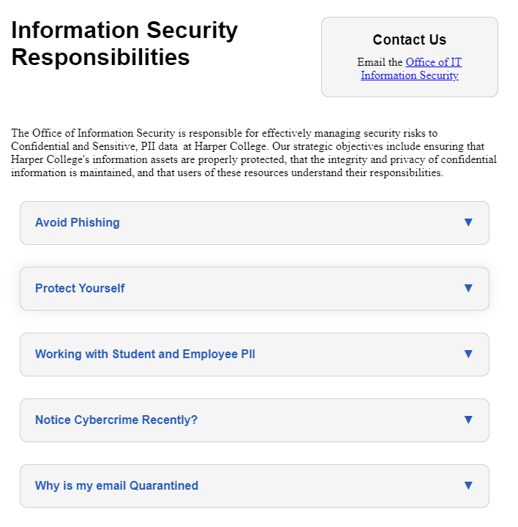
Update the Information Security HIP/external Page
Review existing HIP page
Organize information
Research layouts
Write up new sections
Create a mockup website
Implement new model
Information Security at Harper

Slide 4
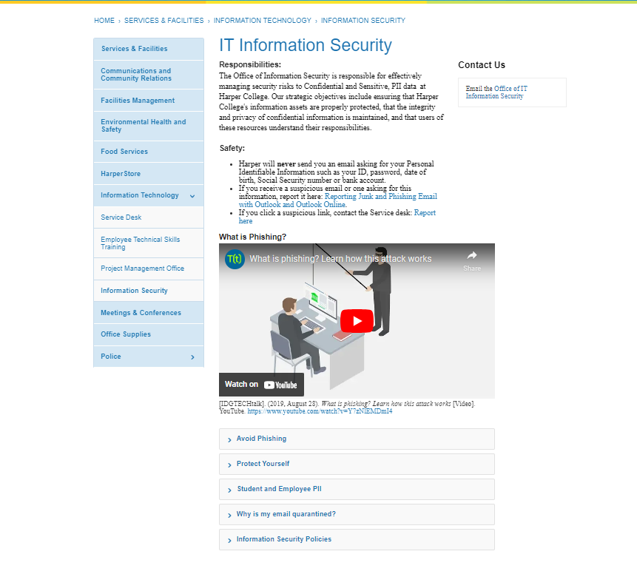
Updated site

Slide 5

Prepare Mock Phishing Emails
Templates chosen
Responses created
Landing page created

Slide 6
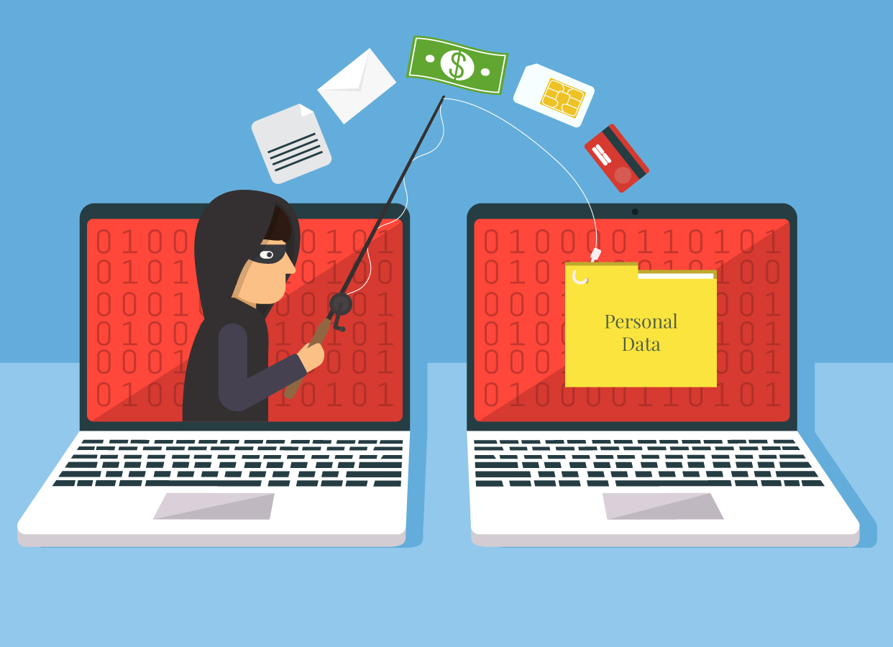
Student Training
Why is it important?
What I did about it?
My conclusion
Notes:
Talk about you as a student who has done training

Slide 7
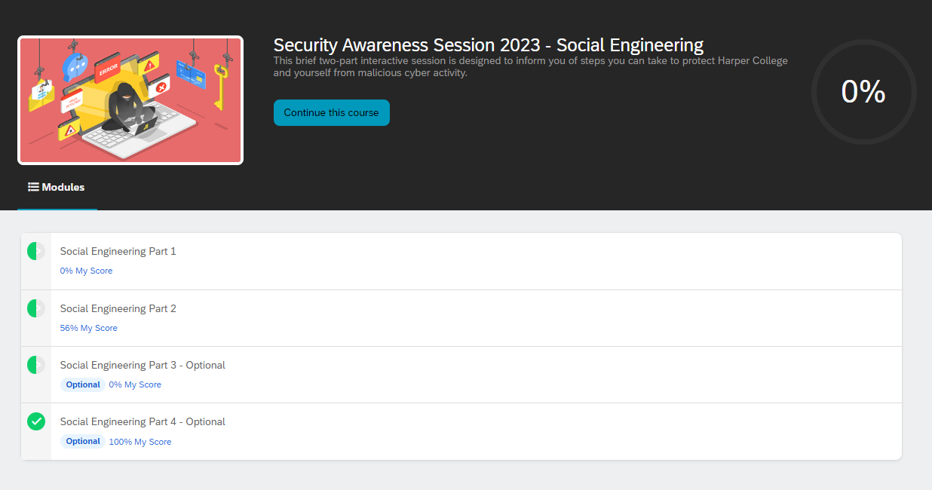
Security Awareness Training
Social Engineering
Why is it important?

Slide 8

Next Steps
Decide on student training options
Implement new external IT page
Roll out security awareness training

Slide 9

My Takeaways
Learned SharePoint
Better understood HTML
Make meetings with vendors
Learned to plan out long projects

Slide 10


THANK YOU
QUESTIONS?

